Slide 1
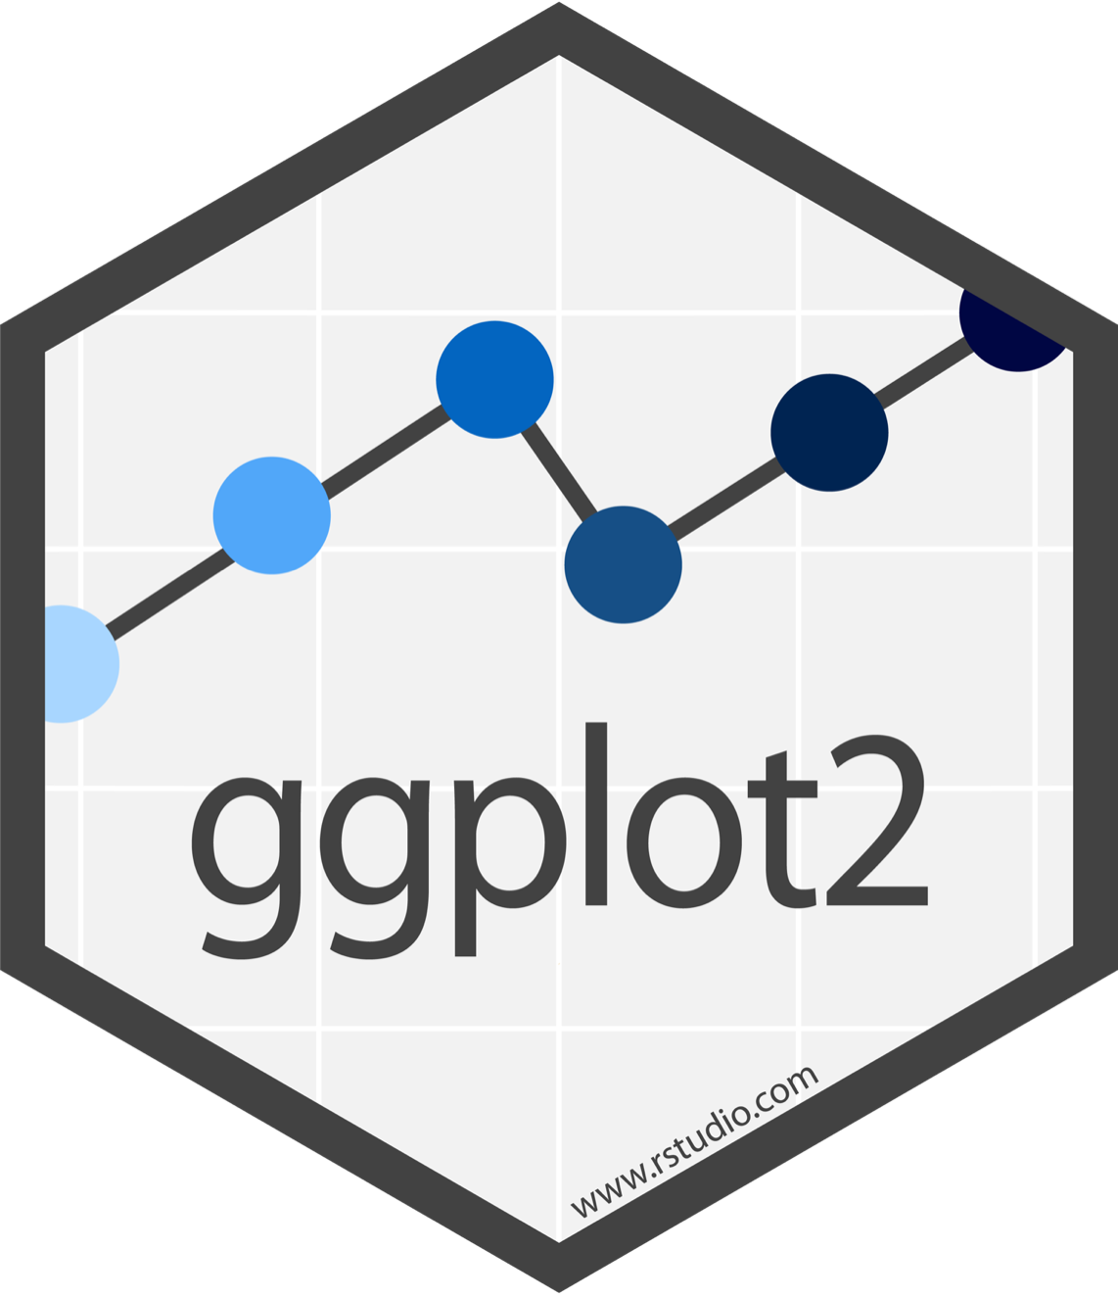
Visualize Data with

Slide 2
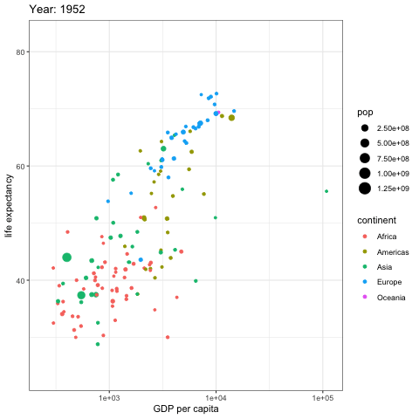
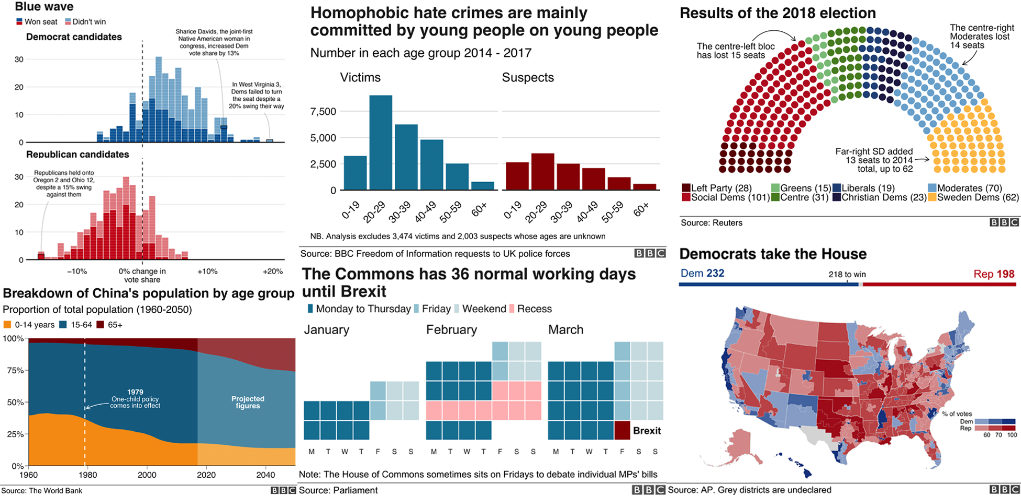
What can ggplot do?
“ggplot2 gives you far more control and creativity than a chart tool and allows you to go beyond a limited number of graphics. Working with scripts saves a huge amount of time and effort, in particular when working with data that needs updating regularly, with reproducibility a key requirement of our workflow.”
-BBC Visual and Data Journalism
How the BBC Visual and Data Journalism team works with graphics in R

Slide 3

(Applied) Data Science
Visualize
Import
Tidy
Model
Communicate
Transform
Program
3

Slide 4
"The simple graph has brought more information to the data analyst’s mind than any other device. "
- John Tukey

Slide 5
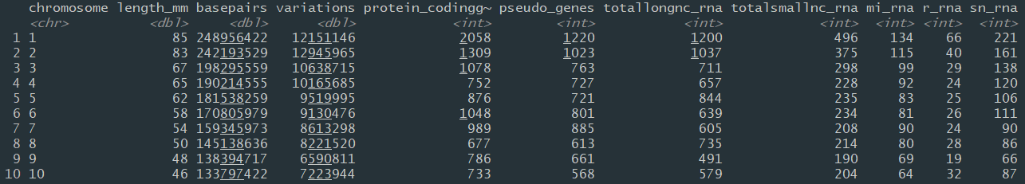
genome
Basic data for all human chromosomes.
genome

Slide 6
Question
What relationship do you expect to see between chromosome size (length_mm) and number of genes (protein_codinggenes)?
6

Slide 7
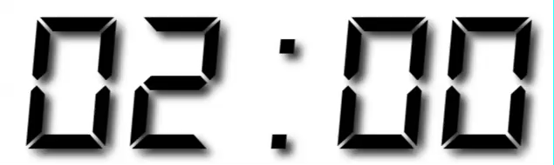
Exercise 1
Run this code in 02-Visualize-Exercises.Rmd to make a graph. Pay strict attention to spelling, capitalization, and parentheses!
ggplot(data = genome) +
geom_point(mapping=aes(x = length_mm, y = protein_codinggenes))
7

Slide 8
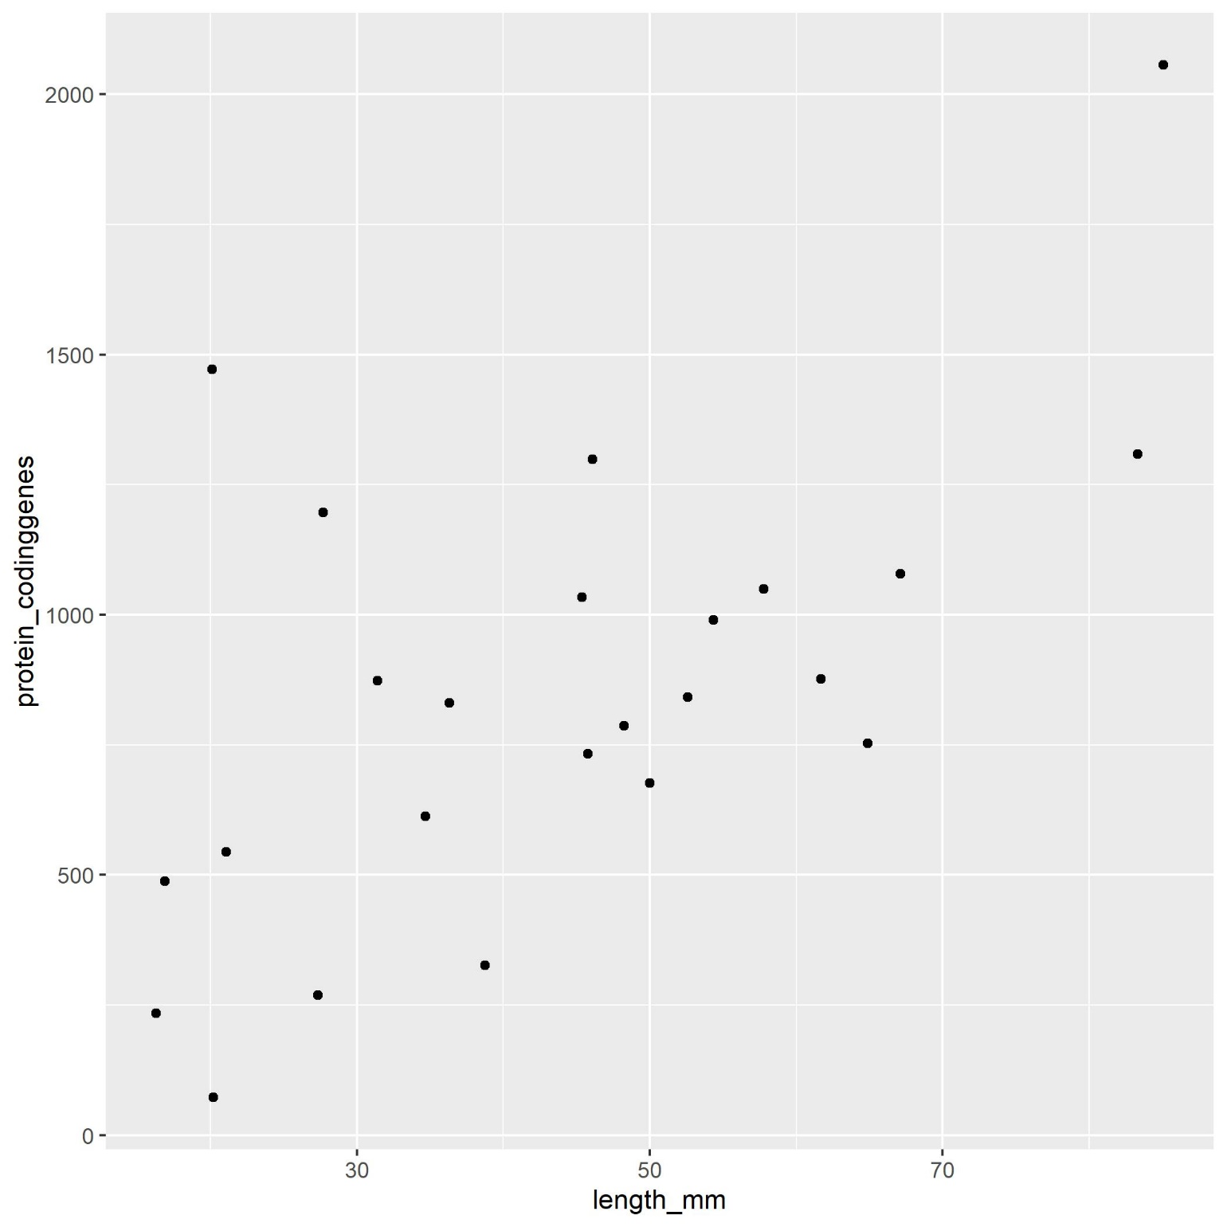
ggplot(data = genome) +
geom_point(mapping=aes(x = length_mm, y = protein_codinggenes))

Slide 9
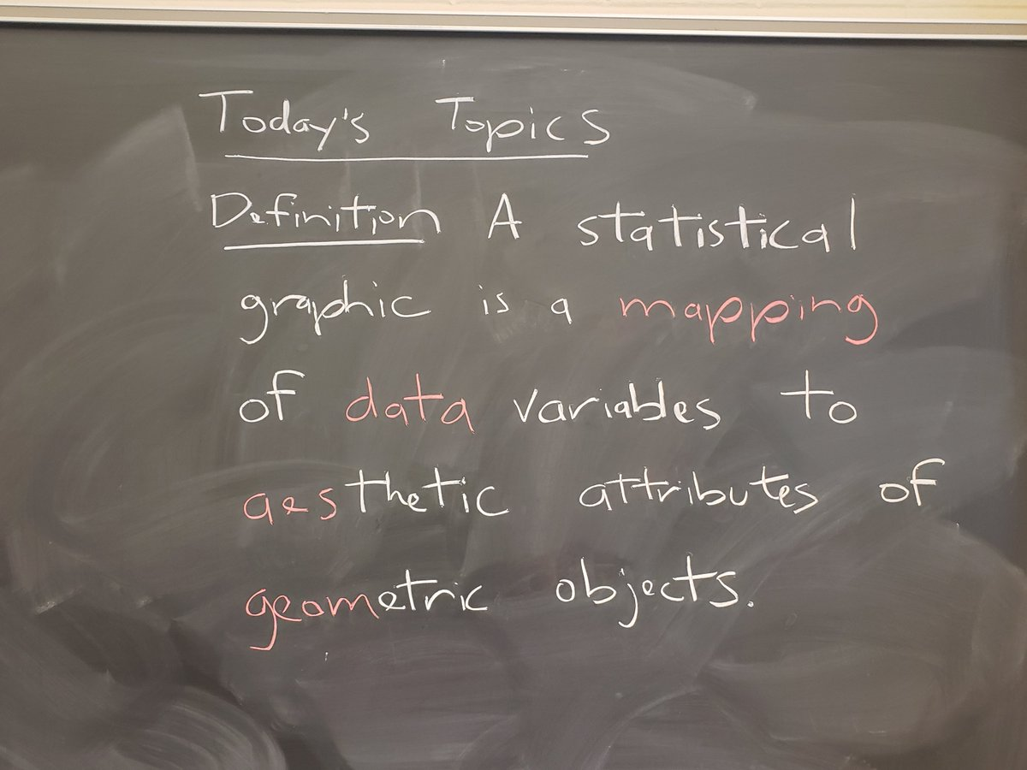
ggplot(data = genome) +
geom_point(mapping=aes(x = length_mm, y = protein_codinggenes))

Slide 10
"Initialize" a plot with ggplot()
Add layers with geom_ functions
ggplot(data = genome) +
geom_point(mapping=aes(x = length_mm, y =protein_codinggenes))
10

Slide 11
Pro tip: Always put the + at the end of a line, Never at the start
ggplot(data = genome) +
geom_point(mapping=aes(x = length_mm, y =protein_codinggenes))
11

Slide 12
data
+ before new line
ggplot(data = genome) +
geom_point(mapping=aes(x = length_mm, y =protein_codinggenes))
type of layer
aes()
x variable
y variable
12

Slide 13
A template
ggplot(data = <DATA>) +
<GEOM_FUNCTION>(mapping = aes(<MAPPINGS>))
ggplot(data = genome) +
geom_point(mapping=aes(x = length_mm, y =protein_codinggenes))

Slide 14
A template
ggplot(data = <DATA>) +
<GEOM_FUNCTION>(mapping = aes(<MAPPINGS>))

Slide 15
A template
ggplot(data = <DATA>) +
<GEOM_FUNCTION>(mapping = aes(<MAPPINGS>))

Slide 16
A template
ggplot(data = <DATA>) +
<GEOM_FUNCTION>(mapping = aes(<MAPPINGS>))
=
ggplot(<DATA>) +
<GEOM_FUNCTION>(aes(<MAPPINGS>))

Slide 17

Mappings

Slide 18
Geoms

Slide 19
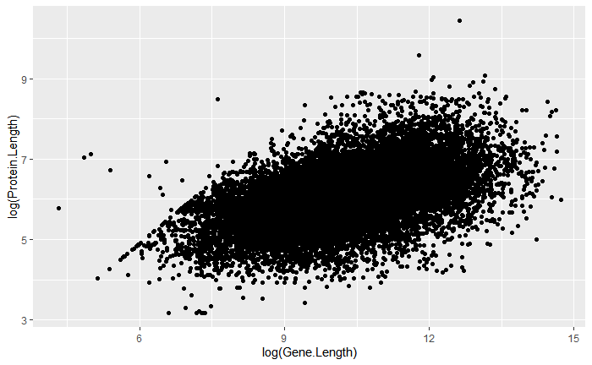
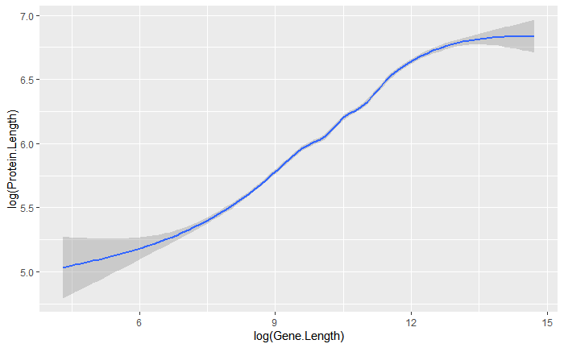
How are these plots similar?
Same:
x var
, y var
, data
ggplot(uniprot_region)+
geom_point(aes(x=log(Gene.Length), y=log(Protein.Length)))
ggplot(uniprot_region)+
geom_smooth(aes(x=log(Gene.Length),
y=log(Protein.Length)))

Slide 20
How are these plots different?
Different: geometric object (geom),
e.g. the visual object used to represent the data
ggplot(uniprot_region)+
geom_point(aes(x=log(Gene.Length), y=log(Protein.Length)))
ggplot(uniprot_region)+
geom_smooth(aes(x=log(Gene.Length),
y=log(Protein.Length)))

Slide 21
geoms
ggplot(<DATA>) +
<GEOM_FUNCTION>(aes(<MAPPINGS>))
How do I know which geom to use?
21

Slide 22


rstudio.cloud/learn/cheat-sheets
Click
CheAT Sheets
in the sidebar

Slide 23
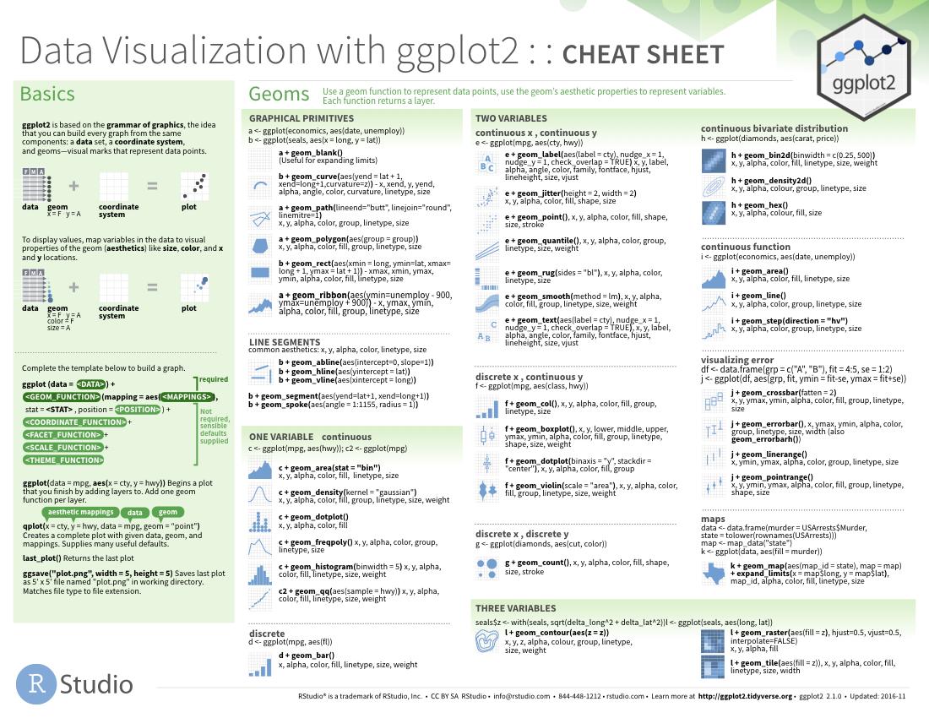
geom_ functions
Each requires a mapping argument.

Slide 24
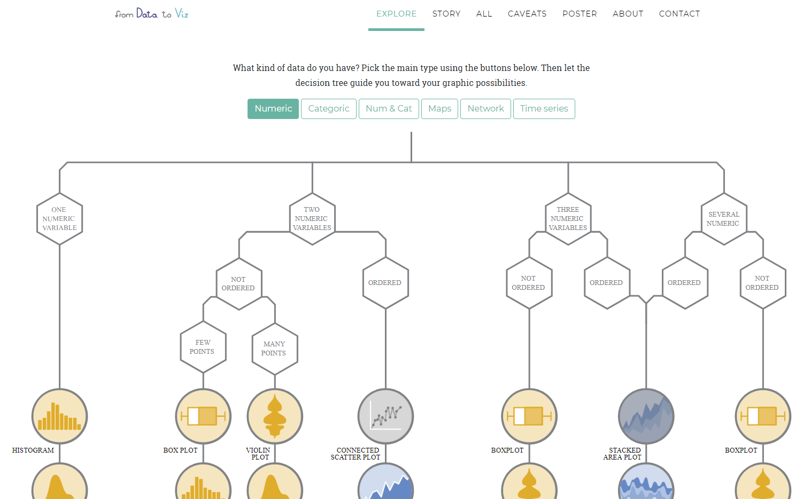
https://www.data-to-viz.com

Slide 25
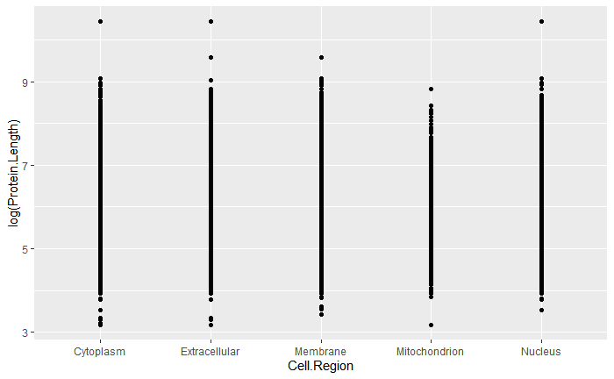
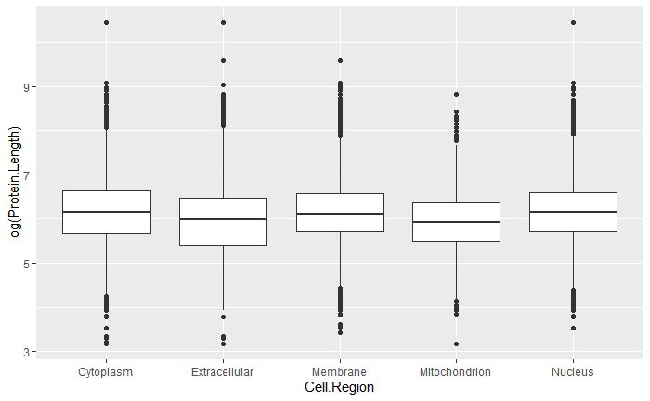
Exercise 2
Decide how to replace this scatterplot with one that draws boxplots. Use the cheatsheet. Try your best guess.
ggplot(uniprot_region) + geom_point(aes(x=Cell.Region,y=log(Protein.Length)))

Slide 26
ggplot(uniprot_region) + geom_boxplot(aes(x=Cell.Region,y=log(Protein.Length)))

Slide 27
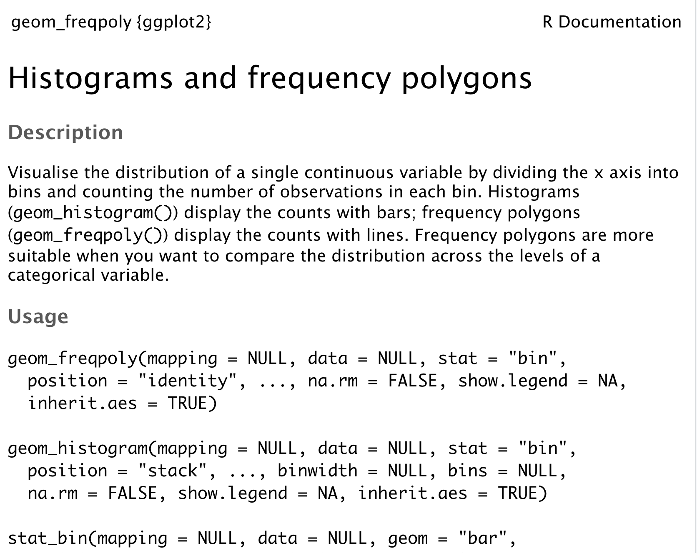
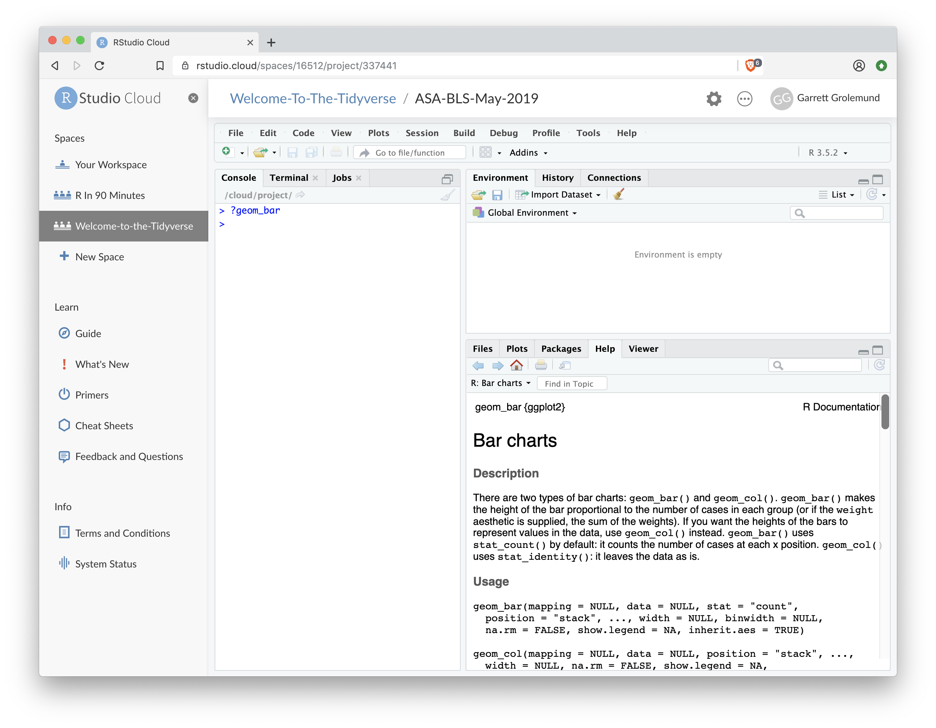
"Help" pages
To open the documentation for a function, type
?geom_histogram
?
function name (no parentheses)

Slide 28
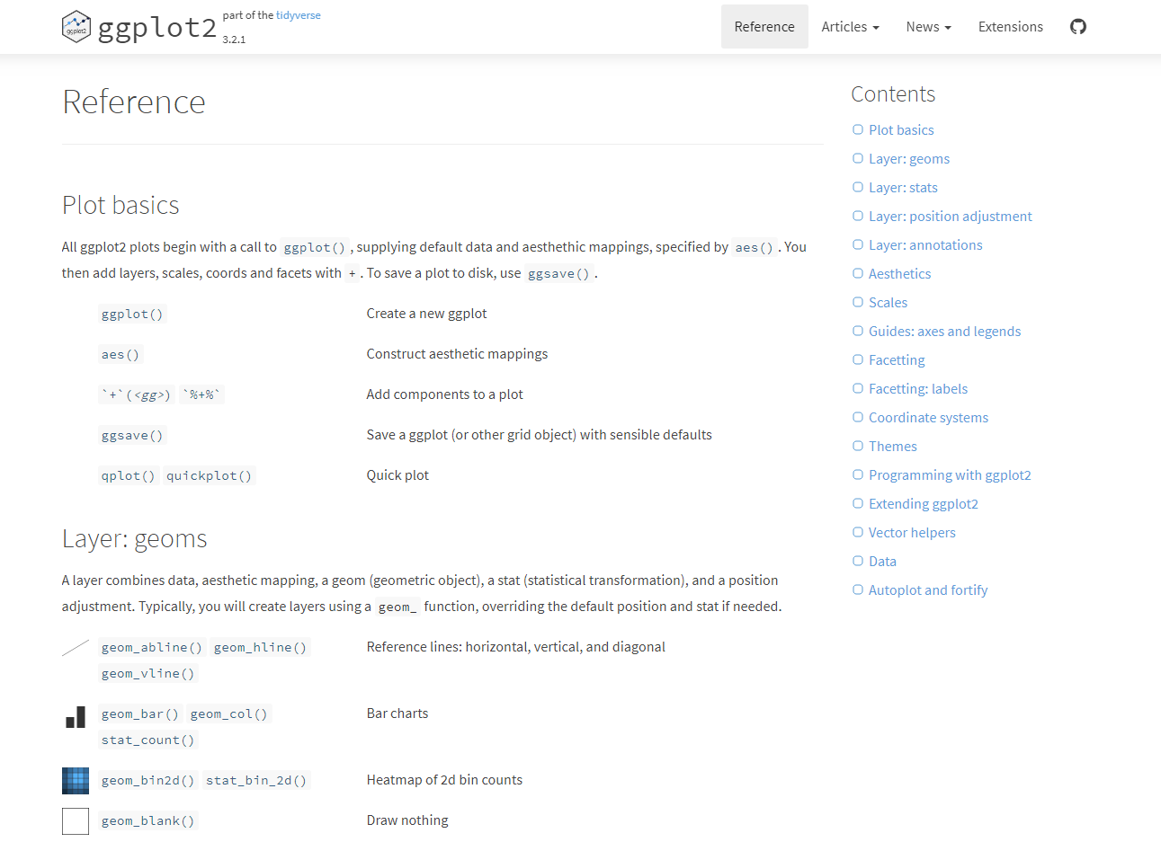
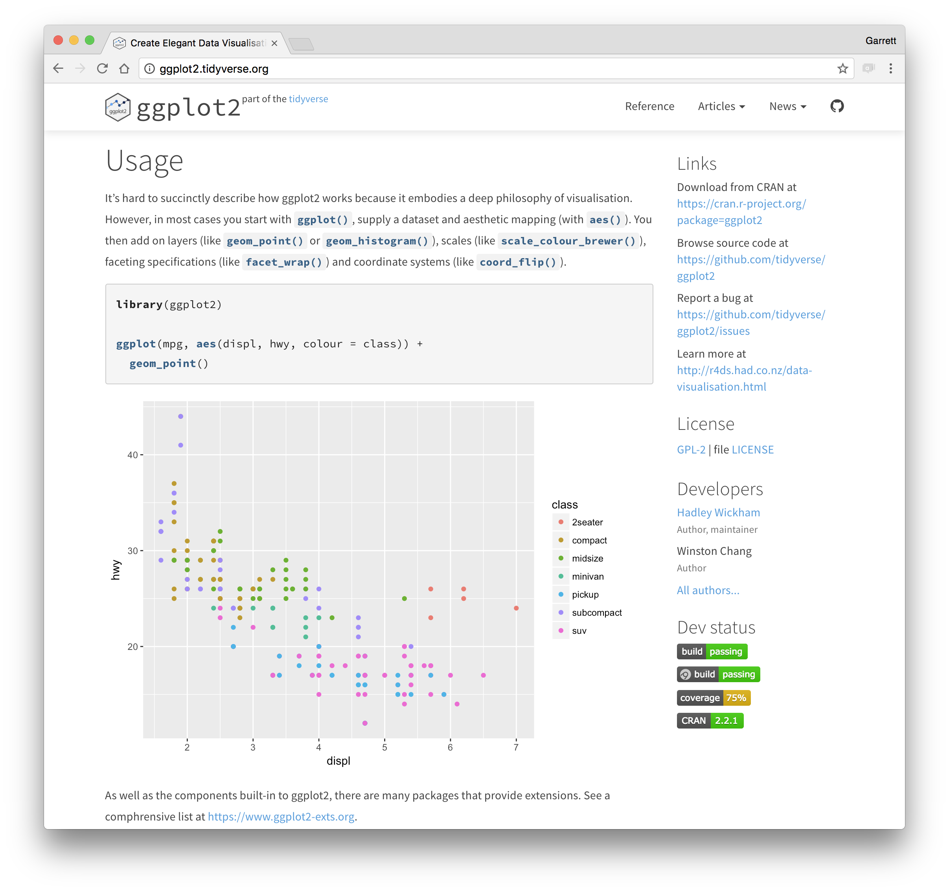
ggplot2.tidyverse.org

Slide 29
Question?
What will this code do?
ggplot(uniprot_region)+
geom_jitter(aes(x=Cell.Region, y=log(Protein.Length)))+
geom_boxplot(aes(x=Cell.Region, y=log(Protein.Length)))
29

Slide 30
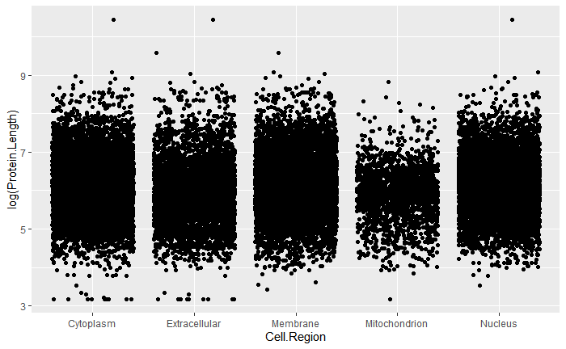
Each new geom adds a new layer
ggplot(uniprot_region)+
geom_jitter(aes(x=Cell.Region, y=log(Protein.Length)))+
geom_boxplot(aes(x=Cell.Region, y=log(Protein.Length)))

Slide 31
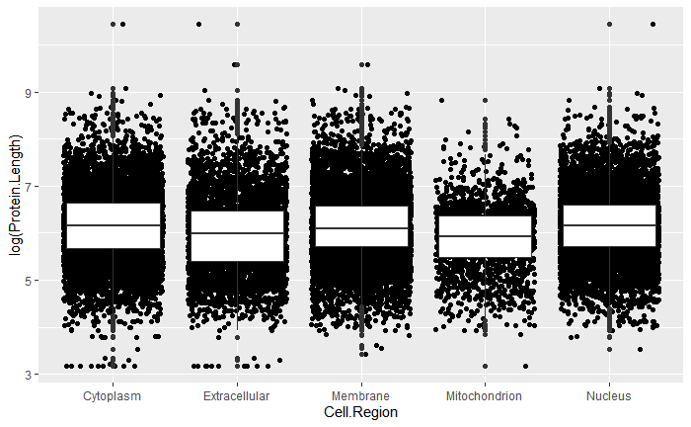
Each new geom adds a new layer
ggplot(uniprot_region)+
geom_jitter(aes(x=Cell.Region, y=log(Protein.Length)))+
geom_boxplot(aes(x=Cell.Region, y=log(Protein.Length)))

Slide 32
Aesthetics

Slide 33
"The greatest value of a picture is when it forces us to notice what we never expected to see."
- John Tukey

Slide 34
What are these smaller genes that make large proteins?
ggplot(uniprot_region) +
geom_point(aes(log(Gene.Length),log(Protein.Length)))

Slide 35
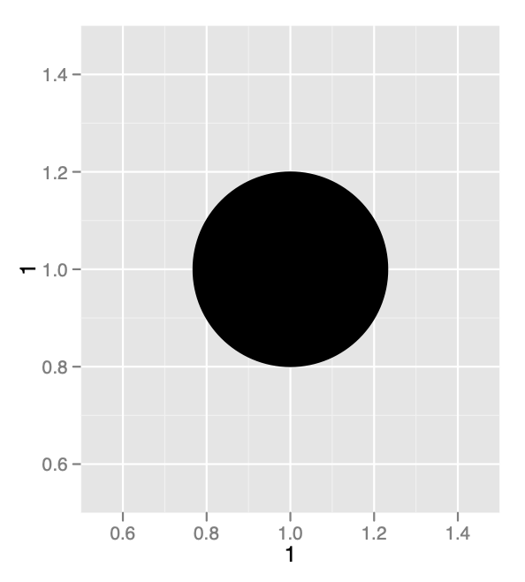
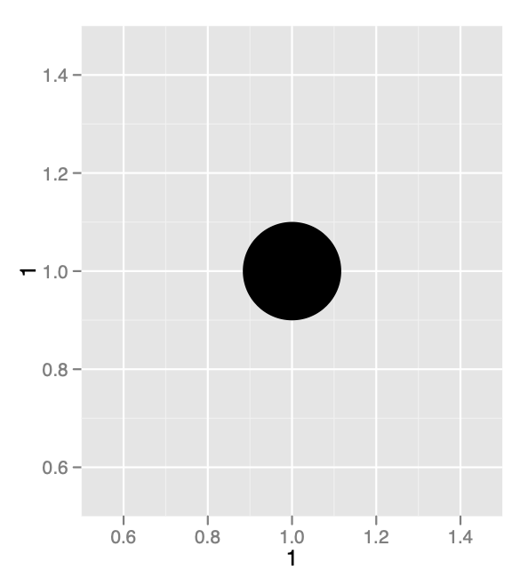
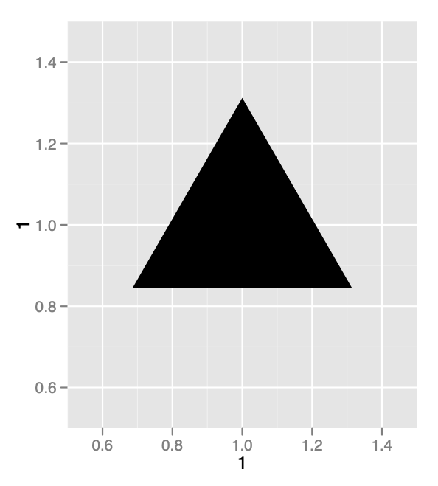
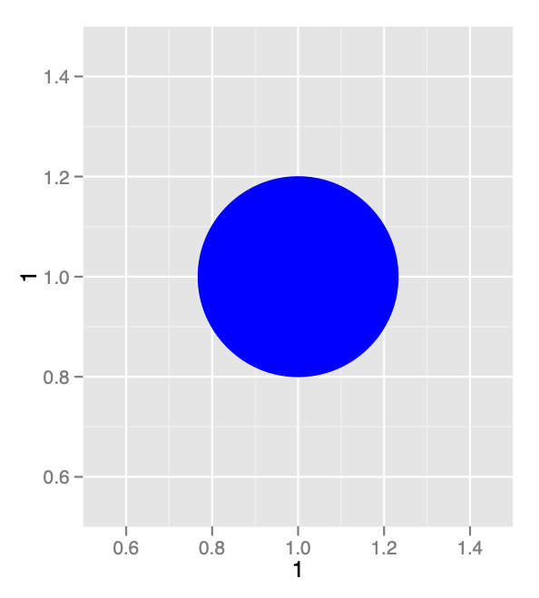
Aesthetics- Shape/Size
35

Slide 36
Aesthetics- Color
Visual Space
Data Space
color
class
Red
Brown
Green
Aqua
Blue
Violet
Pink
2seater
compact
midsize
minivan
pickup
subcompact
suv
36

Slide 37
aesthetic property
Variable to map it to
Aesthetics
ggplot(uniprot_region) +
geom_point(aes(log(Gene.Length),log(Protein.Length), color= Cell.Region))
ggplot(uniprot_region) +
geom_point(aes(log(Gene.Length),log(Protein.Length), size = Cell.Region))
ggplot(uniprot_region) +
geom_point(aes(log(Gene.Length),log(Protein.Length), shape = Cell.Region))
ggplot(uniprot_region) +
geom_point(aes(log(Gene.Length),log(Protein.Length), alpha = Cell.Region))
ggplot(uniprot_region) +
geom_point(aes(log(Gene.Length),log(Protein.Length), fill = Cell.Region))
NOTE: Color vs Fill- depends on shape!
color= outline color, fill = fill color
37
Notes:
Alpha- transparency

Slide 38
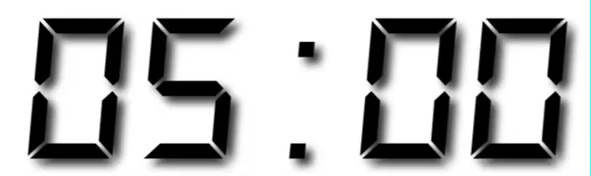
Exercise 3
In the next chunk, add color, size, alpha, and shape aesthetics to your graph. Experiment.
Do different things happen when you map aesthetics to discrete and continuous variables?
What happens when you use more than one aesthetic?
38

Slide 39
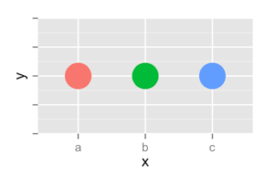
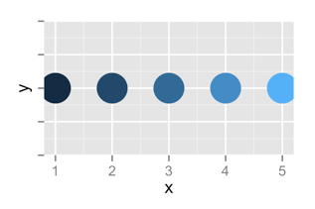
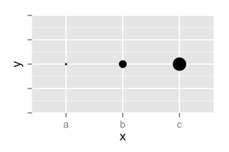
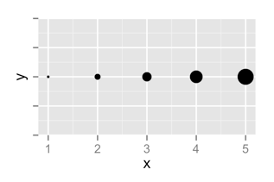
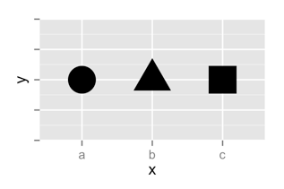
 | Discrete | Continuous
Color
Size
Shape
39

Slide 40
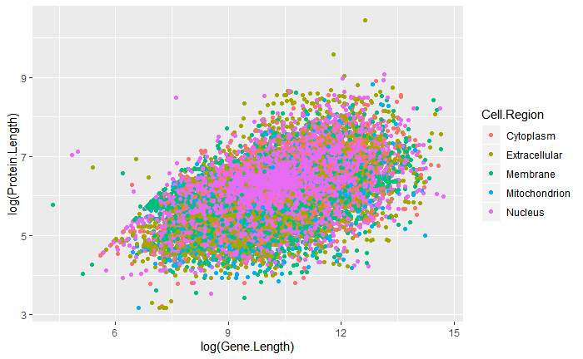
Legend added automatically
ggplot(uniprot_region) +
geom_point(aes(log(Gene.Length),log(Protein.Length), color= Cell.Region))

Slide 41
Exercise 4
What happens when you change the alpha aes?
ggplot(uniprot_region) +
geom_point(aes(log(Gene.Length),log(Protein.Length), fill= Cell.Region, alpha=0.5))
41

Slide 42
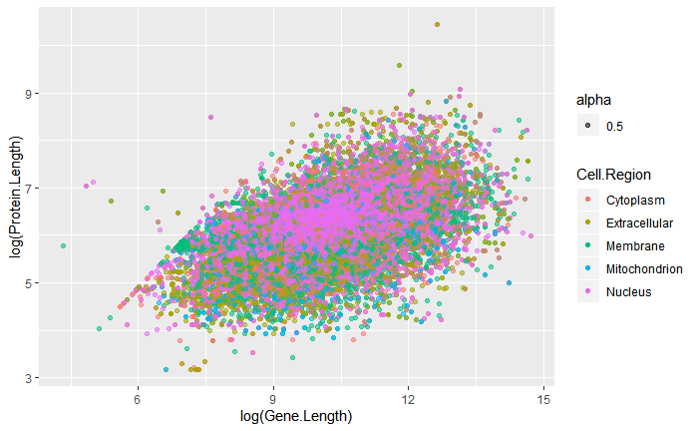
Changes transparency of points
ggplot(uniprot_region) +
geom_point(aes(log(Gene.Length),log(Protein.Length), color= Cell.Region, alpha=0.5))

Slide 43
Error!
ggplot(uniprot_region) +
geom_point(aes(log(Gene.Length),log(Protein.Length)), fill= Cell.Region)

Slide 44
global vs. local

Slide 45
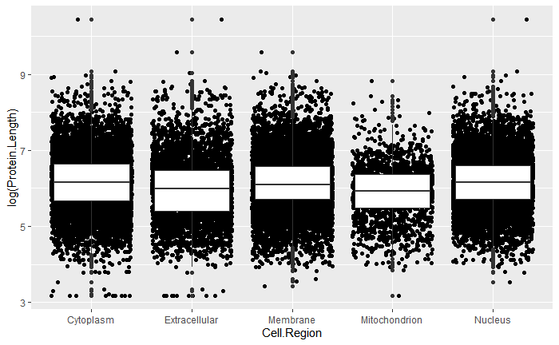
Mappings (and data) that appear in ggplot() will apply globally to every layer
ggplot(uniprot_region, aes(x=Cell.Region, y=log(Protein.Length)))+
geom_jitter()+
geom_boxplot()

Slide 46
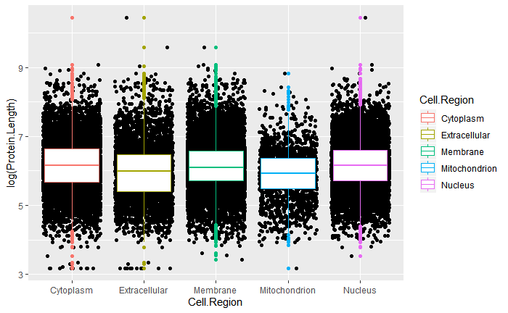
Mappings (and data) that appear in a geom_ function will add to or override the global mappings for that layer only
ggplot(uniprot_region, aes(x=Cell.Region, y=log(Protein.Length)))+
geom_jitter()+
geom_boxplot(aes(color=Cell.Region))

Slide 47
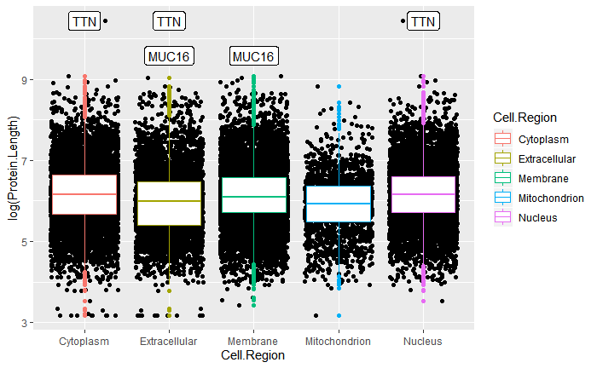
data can also
be set locally
or globally
ggplot(uniprot_region, aes(x=Cell.Region, y=log(Protein.Length)))+
geom_jitter()+
geom_boxplot(aes(color=Cell.Region))+
geom_label(data=large_prot, aes(label= Gene.Name))

Slide 48
Labels and Legends

Slide 49
ggplot(uniprot_region, aes(x=Cell.Region, y=log(Protein.Length)))+
geom_jitter()+
geom_boxplot(aes(color=Cell.Region))+
geom_label(data=large_prot, aes(label= Gene.Name))

Slide 50
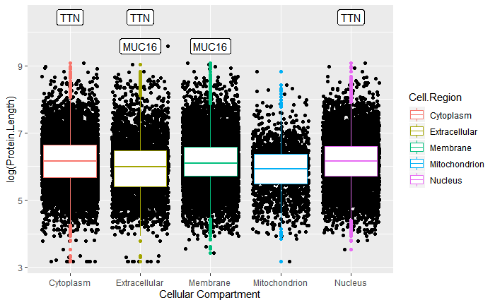
ggplot(uniprot_region, aes(x=Cell.Region, y=log(Protein.Length)))+
geom_jitter()+
geom_boxplot(aes(color=Cell.Region))+
geom_label(data=large_prot, aes(label= Gene.Name))+
labs(x=“Cellular Compartment”)

Slide 51
ggplot(uniprot_region, aes(x=Cell.Region, y=log(Protein.Length)))+
geom_jitter()+
geom_boxplot(aes(color=Cell.Region))+
geom_label(data=large_prot, aes(label= Gene.Name))+
labs(x=“Cellular Compartment”)

Slide 52
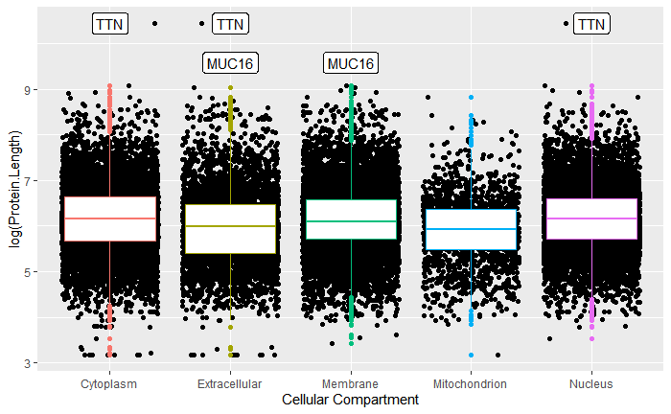
ggplot(uniprot_region, aes(x=Cell.Region, y=log(Protein.Length)))+
geom_jitter()+
geom_boxplot(aes(color=Cell.Region))+
geom_label(data=large_prot, aes(label= Gene.Name))+
labs(x=“Cellular Compartment”)+
guides(fill=“none”)

Slide 53
Exercise 5
Change the x and y axis labels and add a title
ggplot(uniprot_region, aes(x=Cell.Region, y=log(Protein.Length)))+
geom_jitter()+
geom_boxplot(aes(color=Cell.Region))+
geom_label(data=large_prot, aes(label= Gene.Name))
53

Slide 54
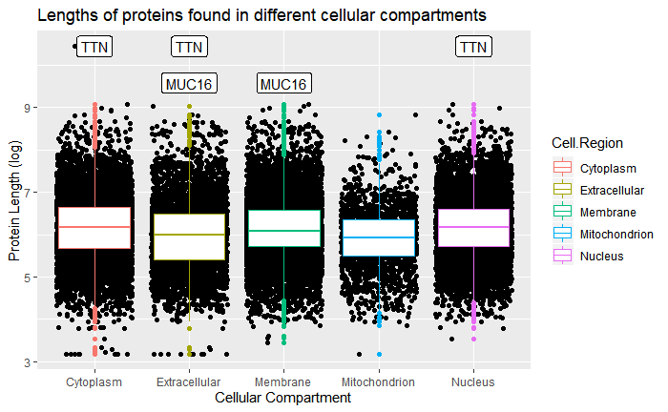
ggplot(uniprot_region, aes(x=Cell.Region, y=log(Protein.Length)))+
geom_jitter()+
geom_boxplot(aes(color=Cell.Region))+
geom_label(data=large_prot, aes(label= Gene.Name))+
labs(x="Cellular Compartment", y="Protein Length (log)", title= "Lengths of proteins found in different cellular compartments")

Slide 55
Facets

Slide 56
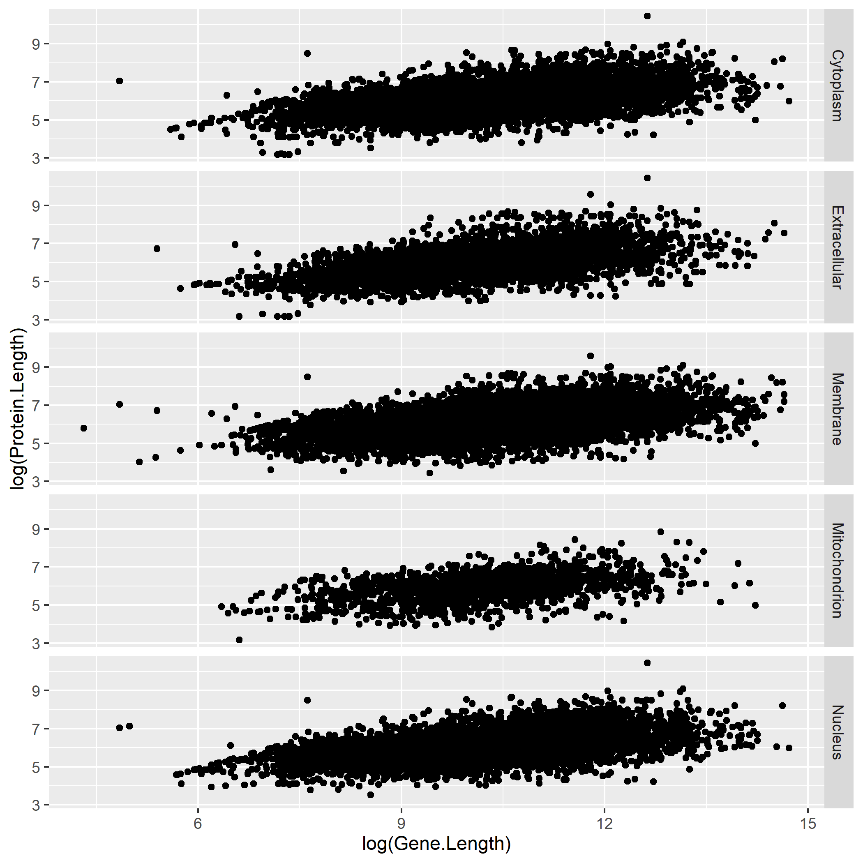
Facets
Subplots that display subsets of the data.
ggplot(uniprot_region)+
geom_point(aes(x=log(Gene.Length), y=log(Protein.Length)))+
facet_grid(rows = vars(Cell.Region))
CC by RStudio

Slide 57
Exercise 6
What do facet_grid and facet_wrap do?
q <- ggplot(uniprot_region) + geom_point(aes(x = Gene.Length, y = Protein.Length))
q + facet_grid(. ~ Cell.Region)
q + facet_grid(Cell.Region ~ .)
q + facet_wrap(~ Cell.Region)
57

Slide 58
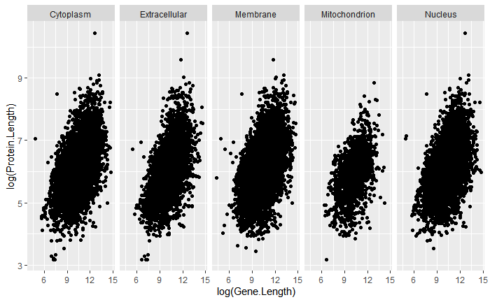
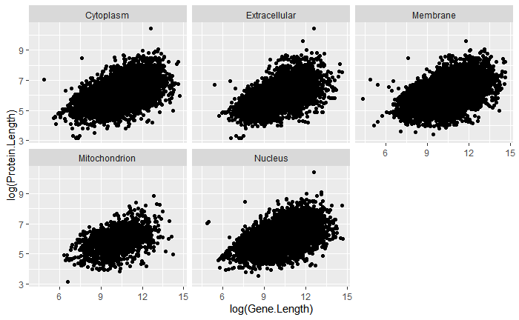
Facets
q + facet_grid(. ~ Cell.Region)
q + facet_wrap(~ Cell.Region)
q + facet_grid(Cell.Region ~ .)
facet_grid() - 2D grid, rows ~ cols, . for no split
facet_wrap() - 1D ribbon wrapped into 2D
CC by RStudio

Slide 59
Saving
graphs

Slide 60
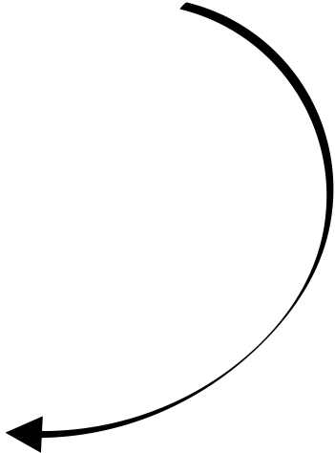
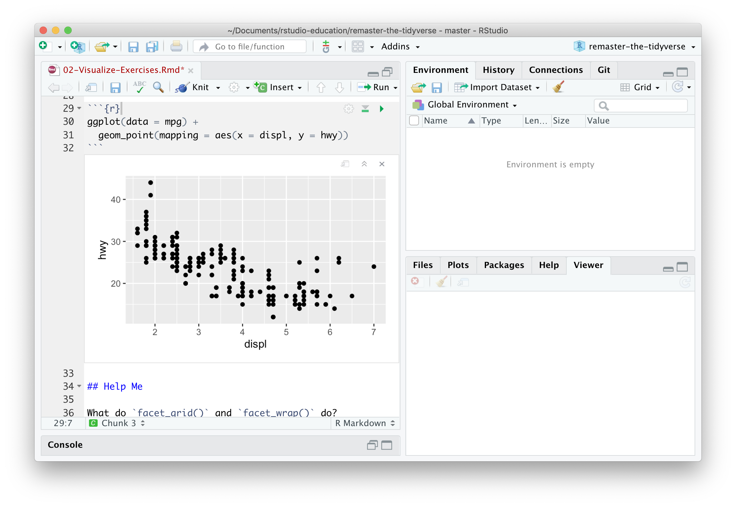
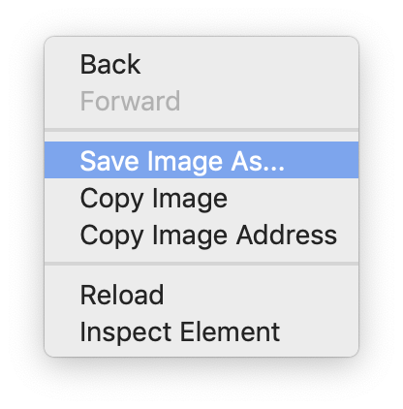
GUI method
Right click on the plot

Slide 61
Code method
ggsave() saves the last plot.
Uses size on screen:
ggsave("my-plot.pdf")
ggsave("my-plot.png")
Q: But where will
it save it?
A: Alongside
your .Rmd
Specify size in inches
ggsave("my-plot.pdf", width = 6, height = 6)

Slide 62
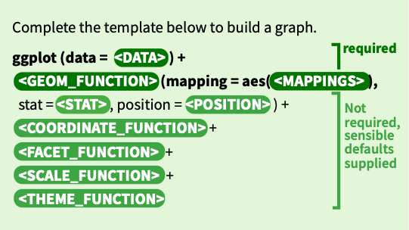
A ggplot2 template
Make any plot by filling in the parameters of this template
62

Slide 63
Your Turn
Open the Day-3---ggplot2-hw.Rmd
63

